Slide 1
Services & Notifications
COMP 3717- Mobile Dev with Android Tech

Slide 2
What are services?
If you remember back to the lecture on intents (week 2)
Intents allow us to communicate between app components
App components are the essential building blocks of the app
Activity
Service
Broadcast receivers
Content providers

Slide 3
What are services? (cont.)
A Service can be started from another app component through intents
Then it runs independently of the component that started it
A service is an application component that performs operations in the background
Imagine an activity without a user interface

Slide 4
Types of services
Foreground
Contains a persistent notification that cannot be dismissed unless service is stopped
System will not kill app/service if low on CPU or memory
Background
Similar to foreground service but without the user being directly aware it
No notification
System will kill app if low on CPU or memory
Bound
Allows app components to interact with a foreground or background service

Slide 5
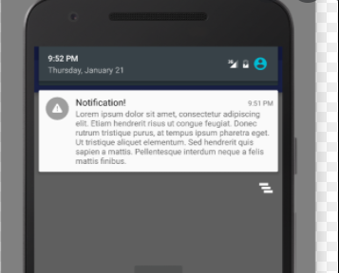
Foreground Bound service
Today we are going to create a foreground bound service
Our app will be running in the background and will display a persistent notification for us like this

Slide 6
Foreground Bound service (cont.)
We will create a music player app, that plays music in the background
We will bind MainActvity to our MusicPlayerService so we can gain a little control over the music and display some information
The idea is to be able to play music in the background while we can use other apps

Slide 7
First things first
Download the incomplete MusicMania project from learning hub
You will notice a few resources and files in there already
mp3 files in raw directory
Strings inside strings.xml
Activity_main.xml and row_layout.xml
MusicFunAdapter.java filled in for recycler view

Slide 8
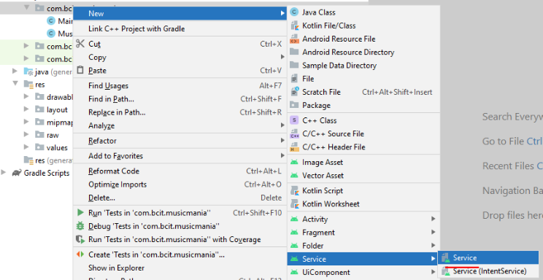
Creating a service
To create a service, right click your class directory
New->Service->Service

Slide 9
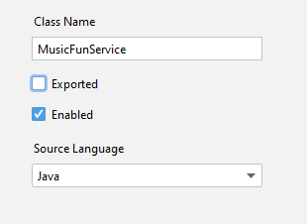
Creating a service (cont.)
You can call it MusicFunService and just check enabled

Slide 10
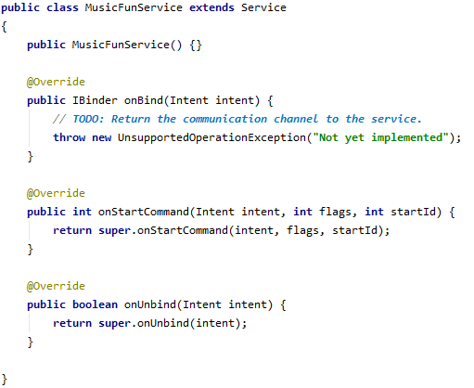
Creating a service
You will notice the class extends Service and an onBind method is created for you
Also override
onStartCommand
onUnbind
onDestroy

Slide 11
Creating a service
onStartCommand()
This is invoked when we call startService from another activity or component
Once started it begins to run in the background
onBind()
This is invoked when we call bindService from another activity or component
It binds the component to the service so we can interact with it while its running
onUnbind()
This is invoked when we call unbindService and essentially unbinds the binded app component from the service

Slide 12
Doing stuff in the background
Inside our onStartCommand() callback we want to play and shuffle songs
So, first we need to create a method that plays songs at random
Let's call this method prepareNextSong()

Slide 13
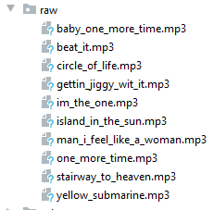
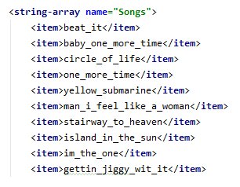
Doing stuff in the background (cont.)
The key parts in this method is going to getting a list of string ids from strings.xml
Since the strings.xml ids match the file names in the raw directory
We can create a MediaPlayer object with one of the random string ids

Slide 14
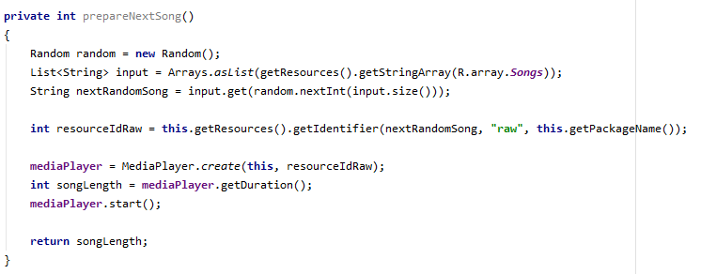
Doing stuff in the background (cont.)
We will return the song length as well, will get to why next

Slide 15
Doing stuff in the background (cont.)
Next, we need to create a method that will continuously play songs for us
For this we can use a Handler object with a Runnable
A Runnable is essentially a task that can be scheduled and repeated
Runnable has a run() callback where we put the code to be scheduled
The Handler is essentially what allows us to schedule Runnables

Slide 16
Doing stuff in the background (cont.)
Lets create a method called shuffleSongs() that schedules a Runnable
Inside the run() method we can prepare for our next song and schedule it to play after the song is over
To do this we use the Handlers postDelayed() method

Slide 17
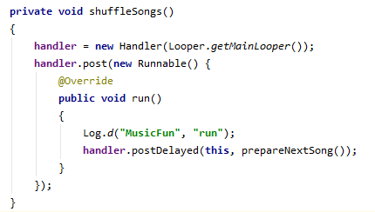
Doing stuff in the background (cont.)
Here is proper way to create this functionality

Slide 18
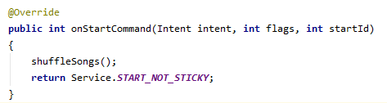
Doing stuff in the background (cont.)
Now lets put shuffleSongs() inside onStartCommand() so our Runnable runs in the background
We will return Service.START_NOT_STICKY which essentially means if the service is killed from low memory it won't start back up.

Slide 19
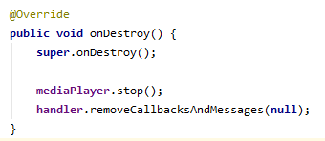
Doing stuff in the background (cont.)
When the service ends we need to clean up any resources being used
inside onDestroy() lets stop the music and remove any pending Runnable's

Slide 20


Starting a Service
Inside MainActivity lets start and stop the service by creating an intent for each
Lets put these inside the onClickShuffle() and onClickPause() methods respectively

Slide 21

Starting a Service (cont.)
Go ahead and run your app and see if you can play music in background!!!

Slide 22

Poll 11

Slide 23


Slide 24
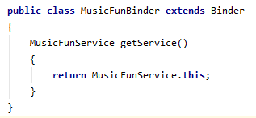
Binding a service
For an app component to bind to our service we need to provide an IBinder class that the onBind() callback can return
This allows our components to communicate
Add a nested class called MusicFunBinder
It will contain one method that return the outer class instance

Slide 25
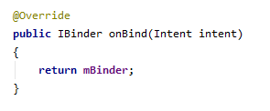
Binding a service (cont.)
Then create an instance variable mBinder
Now return it inside your onBind() callback
If we didn't want to bind an app component to our service, we would just return null here

Slide 26
Binding a service (cont.)
Let's update a few things now in MainActivity so it binds to our Service
We need to implement the ServiceConnection interface and override two methods
onServiceConnected()
Invoked if a connection was created between an app component and a service (bound)
onServiceDisconnected()
When the connection breaks from an unexpected unbinding

Slide 27

Binding a service (cont.)
The onServiceConnected passes in a IBinder which we use to get reference to our service
One we now know the two components are bound we can start the service through an intent here instead of onClickShuffle()

Slide 28
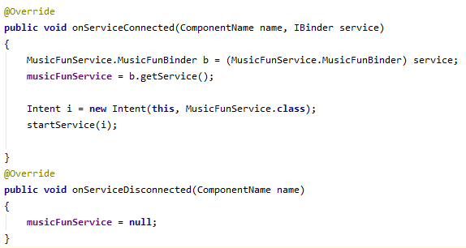
Binding a service (cont.)
Since onServiceDisconnect() will rarely be called lets just nullify our Service object

Slide 29
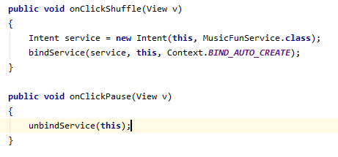
Binding a service (cont.)
Let's update the onClickShuffle() and onClickPause() to bind and unbind now respectively

Slide 30
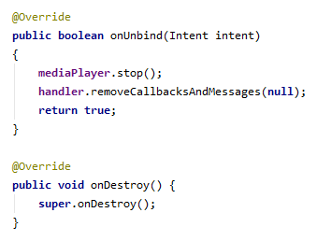
Binding a service (cont.)
Let's jump back over to our Service class
Move the onDestroy() code inside onUnbind()
OnUnbind() will be called when the pause button is now pressed
Make sure to return true in onUnbind() or it won't be able to be called again

Slide 31
Listing the song history
Now that our MainActivity is bound to MusicFunService it will maintain a reference to the service instance, that we can use
We can get information from the service and update our MainActivity.java
Specifically, we can update our RecyclerView with a list of songs that have played, cool!

Slide 32

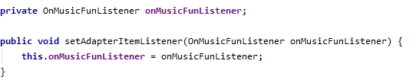
Listing the song history (cont.)
Let's create an interface to help us with code dependency between the two classes
Create an instance variable inside your MusicFunService and a setter for it

Slide 33
Listing the song history (cont.)
Let's also create a List instance variable where we will hold the song names as strings
Create a getter for this List as well

Slide 34
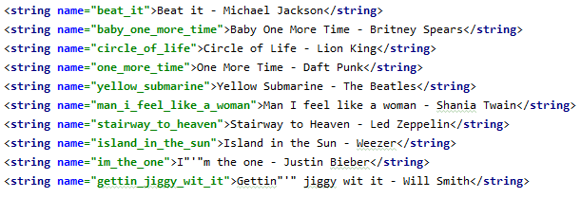
Listing the song history (cont.)
Inside prepareNextSong() add
Here we are getting the String representation of the songs and calling our onNewSong() method from our interface variable

Slide 35
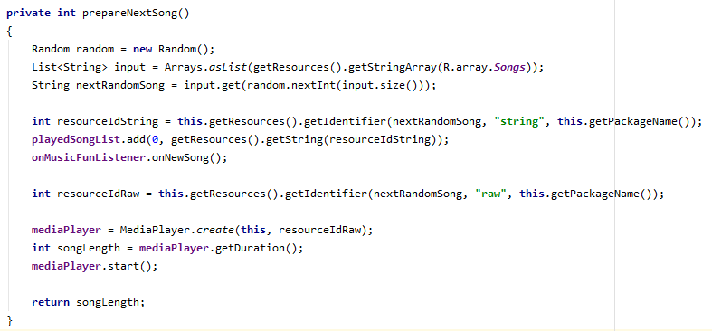
Listing the song history (cont.)
The final code for prepareNextSong()

Slide 36
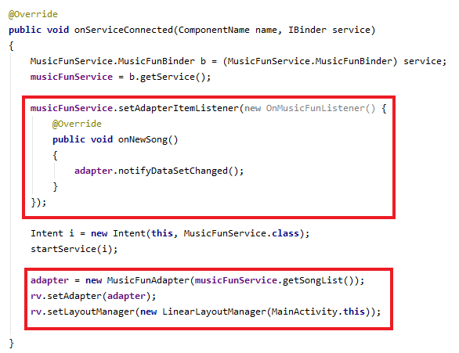
Listing the song history (cont.)
Let's jump back over to the MainActivity.java
Update onServiceConnected() with your recycler adapter code

Slide 37
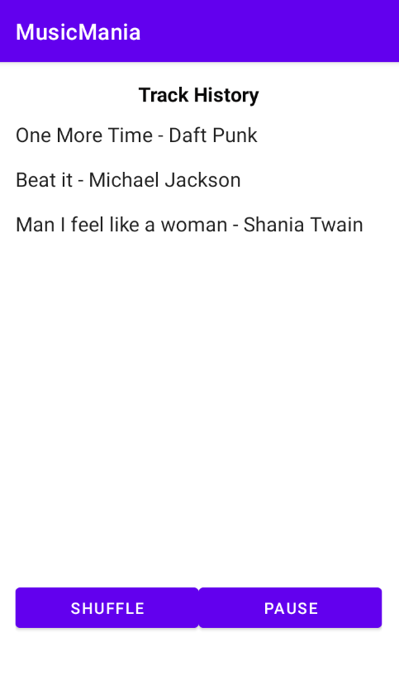
Listing the song history
Go ahead and run your app now and see if your recycler view updates appropriately
Your app will also still run in the background

Slide 38
Making it a foreground service
Remember for our app to be a foreground service we need to add a persistent notification
This way we know our service won't be killed by the system if CPU/memory is low
Let's make a notification for our Service inside MusicFunService.java

Slide 39
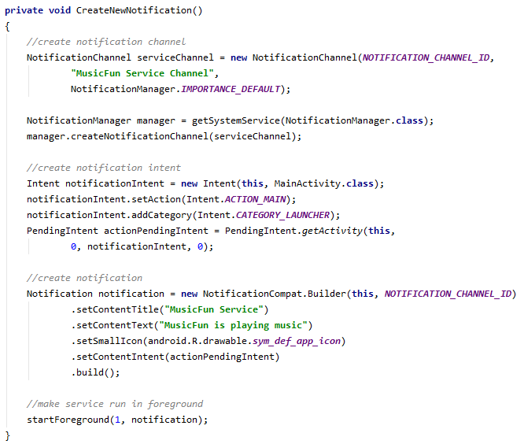

Slide 40
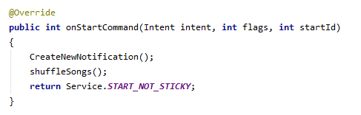
Making it a foreground service (cont.)
Inside your AndroidManifest.xml be sure to give your app permission to a foreground service
Call CreateNewNotification(); inside onStartCommand()

Slide 41
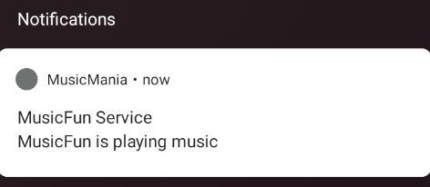
Making it a foreground service (cont.)
Run your app and see now if you have a persistent notification

Slide 42
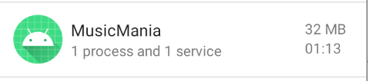
Checking if the service is running
You can check to see if your device is running your service in the developer options on your device
Dependant on device but usually
Settings->System->Advanced->Developer Options->Running Services
**You need to activate developer options on device**
Will show during lecture

